Slide 1
Quarterly report
Q2 – 2018
Australian Small Business and Family Enterprise Ombudsman

Slide 2
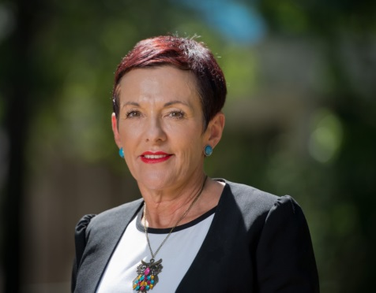
Key activities
The report of our inquiry, Affordable capital for SME growth, was released at the end of this quarter. This important piece of work recommends private and federal government capital funding options to improve SME access to long-term funding.
Following the joint Fairfax/Four Corners investigation in April, Minister Kelly O’Dwyer requested an inquiry into allegations against the ATO, which was led by the Treasury, and supported by ASBFEO and the Inspector-General of Taxation. My office examined over 180 cases and submitted a report with constructive advice and solutions.
A recent focus of the Royal Commission was small business, to which we provided information and briefed counsel assisting. We hope small businesses will get more time before the Commission, as we felt the two weeks were too narrow in focus, leading many businesses to feel their issues had not been addressed.
In April, we released a position paper on workplace relations for small business, identifying practical and simple steps to reduce complexity. Some can be accomplished without legislation and others with minor legislative changes. A Fair Work Commission paper released in July identified similar issues.
Major media appearances – Studio 10 (CH10), ABC 7.30, The Drum, SKY Business News and SKY The Enterprise.
Media interview topics – ATO and small business, cash flow and late payments, banking royal commission, data breaches, access to capital, workplace relations simplification, federal budget, and ASBFEO access to justice survey.
Participated in a successful webinar for small business with ACCC, ATO, ASIC and FWC.
OUTREACH
In late June, we collaborated with the Australian Finance Industry Association, theBankDoctor.org and FinTech Australia on the release of the Fintech Code of Lending Practice. The six largest fintech balance sheet lenders committed to comply with the Code by December 2018. We will now work to get the rest of the industry signed up.
June also saw the official opening of the Small Business Hub by Minister Craig Laundy. The Hub provides small businesses, family enterprises, and representative organisations with a place to work, a venue for meetings and events, and easy access to Parliament House and government departments. With a base now available in Canberra, we hope the voice of the small business sector will be stronger and more consolidated.
Completed our inquiry and report into Affordable capital for SME growth.
Completed collection of the Access to justice inquiry survey data.
Supplied data to the Treasury inquiry into ATO’s conduct towards small business.
Implemented the Fintech Code of Lending Practice
Provided assistance to the Royal Commission.
ADVOCACY
Received 1,324 contacts.
84.7% requested assistance to resolve a dispute.
The main issues of concern related to payments, contracts, financial services providers, leasing, phoenixing and ATO issues.
The majority of the direct contacts to the Assistance team (67%) were business to business disputes
Doubling of contacts from Western Australia (to 8%).
ASSISTANCE
Kate Carnell AO Australian Small Business and Family Enterprise Ombudsman
2

Slide 3
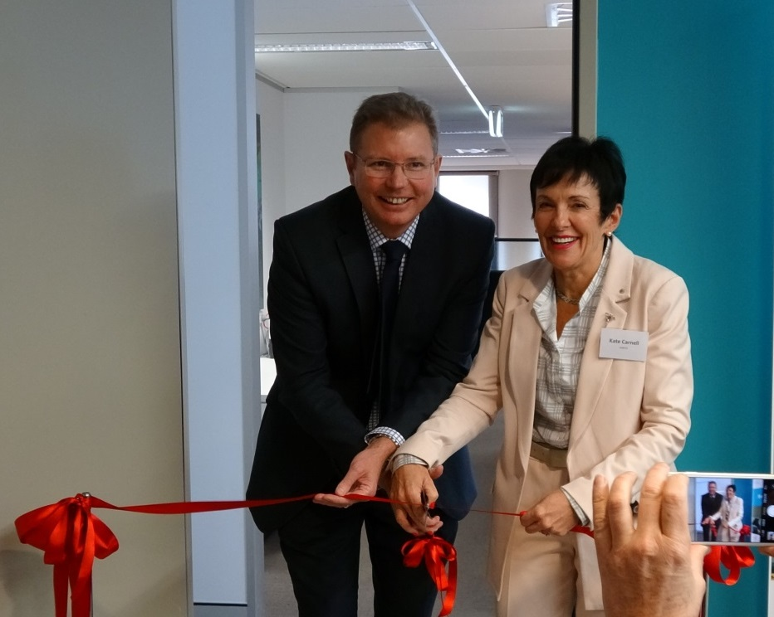
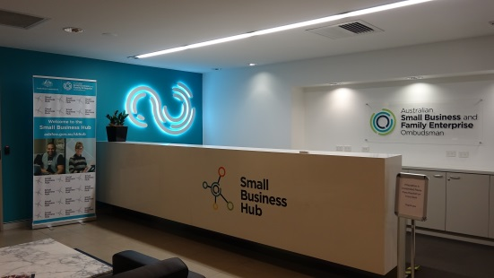
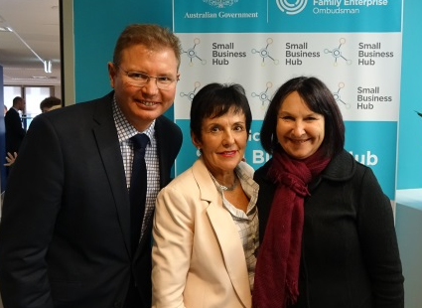
Outreach: communications and stakeholder engagement
The Ombudsman attended 42 meetings with government on behalf of small businesses, and met with 53 key external stakeholders.
The Ombudsman delivered 23 speeches in panel and keynote roles, and attained more than 100 media mentions (radio, TV, print and online).
Our website homepage was refreshed to improve the most commonly accessed areas: dispute support, latest news, latest milestones, newsletter subscription and success stories.
A total of 28 industry organisations with an interest in small business partnered with ASBFEO’s new Small Business Hub, providing their members with work and meeting spaces.
Small Business Hub launched
Left: Minister Craig Laundy, Ombudsman Kate Carnell and Jobs and Small Business Secretary Kerri Hartland launch the Small Business Hub – 29 June 2018. Above: Cutting the ribbon
Traditional and social media
2,541 subscribers
More than 100
mentions
15 media statements released
56,929 visits in 2018
1,464 likes
124 posts
900 engagements
5 videos published
1,800 followers
164 tweets
669 engagements
8,500+ connections
3

Slide 4
Advocacy: a voice on policy and legislation
Affordable capital for SME growth inquiry
Eight key recommendations to increase supply into the capital gap and to help SMEs to be finance ready.
Follows our report Barriers to Investment and other reports that identified a funding gap for long-term SME capital.
Stakeholders have started providing information for SMEs.
Royal Commission
The module on small business was limited. ASBFEO has further ‘intelligence’ to share with the Royal Commission and hopes to have another chance to provide greater input.
Access to justice survey
Security of Payments
The results are in from a targeted survey of 1600 small businesses about when and how they see disputes and the choices they make.
The findings will inform the next phase of the Access to justice inquiry.
The report is due for release in the next quarter.
ASBFEO met with Mr John Murray AM regarding the review of the Security of Payments legislation.
We are analysing the benefits and costs if statutory trusts were implemented in the building and construction industry (Rec 85).
4

Slide 5
Advocacy: a voice on policy and legislation
Submissions – over 25 including:
ATO investigation
Inquiry into the Franchising Code of Conduct – recommendations included strengthening the definition of ‘good faith’ and providing the regulator with rights to investigate suspected breaches; changes to the disclosure document; mandated arbitration; and expressly prohibit unfair contract terms
Responses to Black Economy Taskforce initiatives, including single touch payroll, in increasing the integrity of government procurement and introducing an economy cash payment limit
Terms of reference for Australian Financial Complaints Authority and interim funding model
ASBFEO contributed to Treasury’s investigation of the ATO’s heavy-handed tactics towards small business.
Supplied data from small business submissions on the operation of the system of the administration of tax law as applied to small businesses.
Provided recommendations to ensure ATO powers are used responsibly through:
increasing independent review and certainty
more teeth and enhanced small business focus for the IGT
improving ATO processes and transparency.
Under an FOI request, published the paper provided to the Treasury.
AFCA rules consultation
Small Business Counts – informing policy making
AFCA needs prescribed timelines to give rapid justice.
A bank’s internal dispute resolution decision should be considered its last offer; removing delays from a ‘refer back’ by AFCA.
Two reports are currently underway:
Small Business Counts (last produced in 2016).
Women in small business – updated and expanded to provide the latest statistics. Its purpose is to support women in small business and highlight their contribution.
5

Slide 6
Advocacy: a voice on policy and legislation
Payment times and practices
Fintechs
National Payment Transparency Register
Fintech Code of Lending Practice has been implemented with six initial signatories.
The Code will have an independent Code Compliance Committee to be finalised in 2018.
ASBFEO continues to convene the Fintech Steering Group to monitor progress of initiatives.
Five more signatories have joined the register, bringing the total to 27.
Forty-six top 100 ASX companies were invited to join.
Commenced plans for an online version of the register.
Supplier Payment Code Review
Current joint project – A guide to borrowing from fintech lenders for small business. Developed by ASBFEO and the BankDoctor.org, this resource is currently in the user-testing and consultation phase.
The Ombudsman is on the panel to review the Business Council of Australia Supplier Payment Code.
Terms of reference focus on fitness-for-purpose and whether it is improving payment times and practices.
6

Slide 7
Advocacy: a voice on policy and legislation
ASBFEO Policy Forum
Missed opportunities
The seven working groups are well established with round three of working groups in progress.
Members joined the Small Business Hub and shared Access to Justice survey.
Digital uptake strategy and additional fast fact sheets soon to be finalised.
The consequences of ASBFEO not being consulted.
Royal Commission
Unanswered questions regarding Commonwealth Bank of Australia’s treatment of Bankwest commercial loans, which was a key driver for establishing the Royal Commission.
Australian Financial Complaints Authority
ASBFEO National Strategy Group
The regulations and rules for AFCA don’t meet the need for a small business to have disputes resolved quickly. Small business can’t function with no access to their bank accounts during a dispute.
May’s meeting focused on skills training programs and business disruption resources to assist small business during infrastructure projects.
The group assisted with distributing a survey for the Access to Justice inquiry.
Therapeutic Goods Administration
Industry associations have raised concerns regarding the TGA’s lack of effective consultation with impacted small business stakeholders on policy changes – homeopathy review and the new medical devices tax. In both instances, the impacts were not fully assessed.
Launch of Phoenix hotline
Workplace relations
This may assist the ATO to identify illegal phoenix activity and take action quickly. It does not protect a small business, who are most likely an unsecured creditor or subcontractor. They are the last to be paid, if at all.
A position paper on practical solutions to simplify award compliance for small business released in April, including:
online decision making tools and dispute resolution tool by Fair Work Commission.
ASIC Fees for Service
Failure to consider impacts on small business e.g. financial services licences fees - over $15,000 per licence
7

Slide 8
Assistance: support for SMEs
Resolution pathways
1,324 contacts received via phone, email and web inquiry. Of these 556 were direct ASBFEO contacts, and 768 were via the ASBFEO Infoline.
50%
4%
1,122 were requests for assistance. 71% of contacts came from small business owners, family enterprises and sole traders.
25%
4%
17%
Contacts from Queensland decreased by 26%
The majority of the direct contacts were business to business disputes
2%
28%
8%
5%
23%
67% of disputes were business to business
33% of disputes were business to government
7%
Contacts from Western Australia doubled this quarter
16%
18%
3%
8

Slide 9
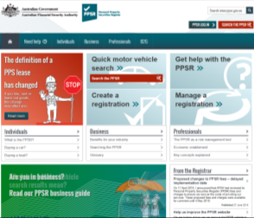
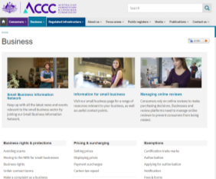
Next steps
Develop and implement a social media strategy to increase our small business, advocacy and media reach.
As a sponsor, ASBFEO staff will participate in the COSBOA Small Business Summit in August.
The Ombudsman will continue to feature at conferences, business events, videos and a bespoke podcast for chartered accountants.
OUTREACH
Participate in COSBOA Small Business Summit
Publish the guide on borrowing from fintechs.
Monitor compliance with the fintech Code of Lending Practice and the establishment of the governing body.
Release Access to justice report and launch phase II of the inquiry.
Develop a guide on lending products for SMEs.
Raise awareness of Personal Property Security Register and its use.
Work with the BCA to undertake review of the Suppliers Code.
Publish resources on small business data through an updated Small Business Counts report.
ADVOCACY
Raise awareness of the Personal Property Security Register
Finalise recruitment of new case managers to help with the increasing requests for assistance.
Continue working on various papers regarding emerging issues affecting small business, in particular, the print/photocopy industry. We aim to present the paper to the ACCC.
Continue working with other agencies to understand how we can best assist small business.
ASSISTANCE
Highlight issues in print/photocopy industry to ACCC
9

Slide 10
Copyright notice
http://creativecommons.org/licenses/by/3.0/au/
With the exception of coats of arms, logos, emblems, images, other third-party material or devices protected by a trademark, this content is licensed under the Creative Commons Australia Attribution 3.0 Licence.
We request attribution as © Commonwealth of Australia (Australian Small Business and Family Enterprise Ombudsman) 2018.
All other rights are reserved.
Icons in this document were used under a Creative Commons license from the Noun Project (http://thenounproject.com). Permission may need to be obtained from third parties to re-use their material.
Written enquiries may be sent to:
Manager Media and Communications Australian Small Business and Family Enterprise Ombudsman 02 6263 1500 media@asbfeo.gov.au
10

Slide 11
Canberra
Level 2
15 Moore Street
Canberra ACT
Sydney
Level 5
100 Market Street
Sydney NSW 2000
GPO Box 1791
Canberra City ACT 2601
T 1300 650 460 E info@asbfeo.gov.au
Twitter : @ASBFEO
Facebook: @ASBFEO
LinkedIn: Australian Small Business and Family Enterprise Ombudsman
YouTube : Australian Small Business and Family Enterprise Ombudsman
Other useful contacts
NSW Small Business Commissioner
T 1300 795 534 E we.assist@smallbusiness.nsw.gov.au
SA Small Business Commissioner
T 1800 072 722
E sasbc@sa.gov.au
VIC Small Business Commissioner
T 138 722
E enquiries@vsbc.vic.gov.au
WA Small Business Commissioner
T 131 249
E info@smallbusiness.wa.gov.au
Australian Competition and Consumer Commission
T 1300 302 021 W www.accc.gov.au
Fair Work Ombudsman
T 1300 799 675 W www.fairwork.gov.au
Australian Securities and Investment Commission
T 1300 300 630 W www.asic.gov.au
Australian Taxation Office
T 13 72 26 W www.ato.gov.au

